Slide 1

Amazon Beauty Product Recommendation
Recommendation Problem :
The objective of the analysis is building Recommendation Engine that recommends Beauty Products to customer based on Product Type by reviewing customer ratings.
UserId | ProductId | Rating | Timestamp

Slide 2





EDA & Visualization
Web Scraping
Model Building
Recommendation
Deployment

Slide 3
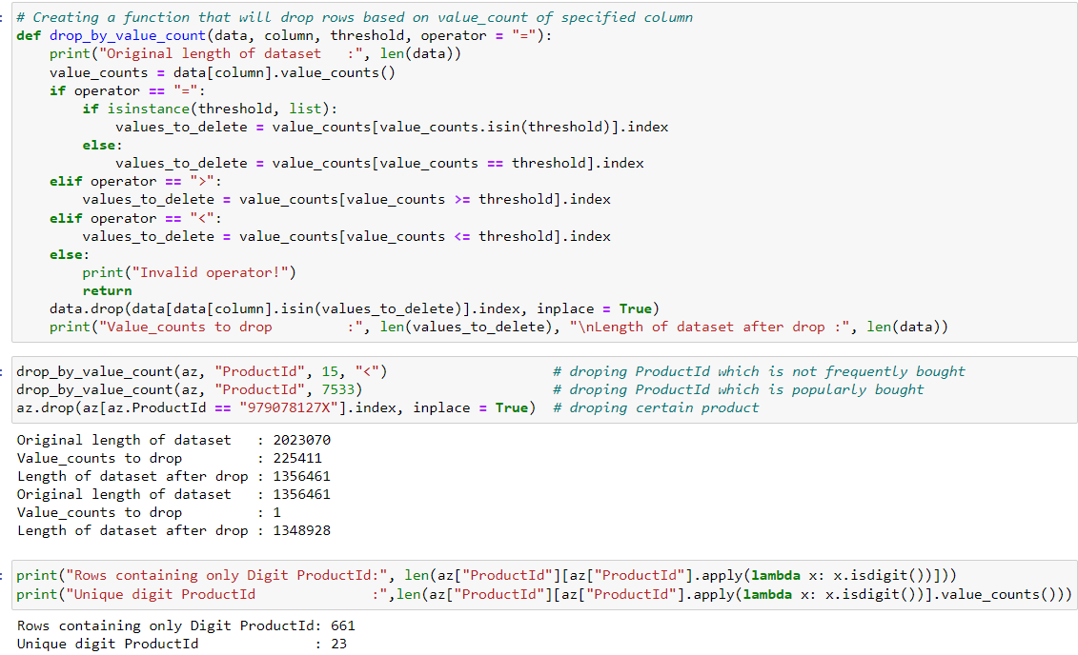

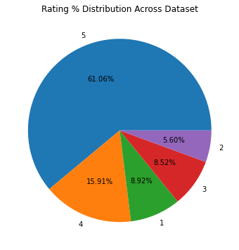
EDA & Visualization
Having majority data of rating 5 and least of rating 2
Dropped ProductId which are most popular and the ones which are not frequent
Length of the dataset dropped from 2 Millions to direct 1.34 Million
With Unique ProductId of 23

Slide 4
Assigning Beauty Product Category to unique 23 ProductId based on starting similarities of ProductId
This will help to scrape data based on Product Types
Having Nail Polish with highest number of frequency i.e. 5993 and Eyeliner & Kajal the least i.e. 11
And other Product Type within its range

Slide 5
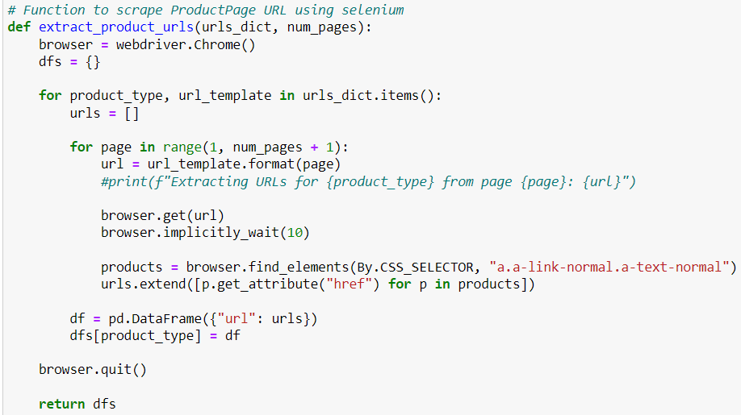

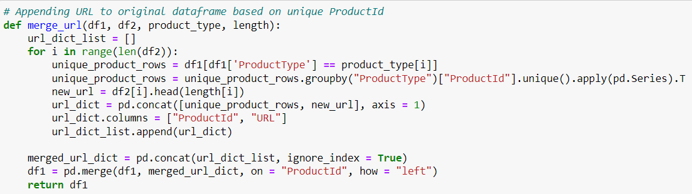
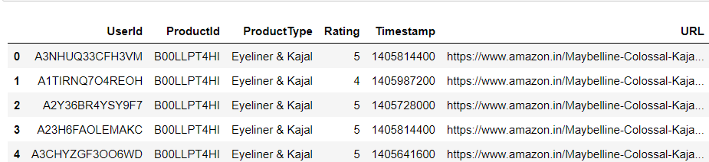
Web Scraping
Web Scraped Product URL from Amazon using Selenium library
Appending URL to original dataframe based on unique ProductId
Merging all and have a single dataset by saving it
Final Dataset have the columns:
UserId | ProductId | ProductType | Rating |
Timestamp | URL

Slide 6
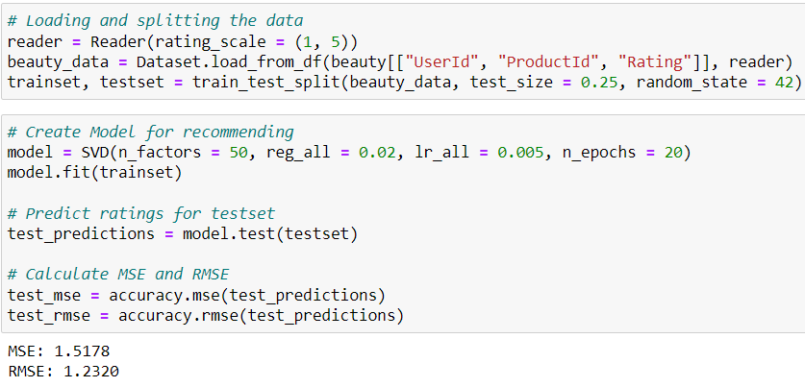

Model Building
On the Final dataset building model using Surprise library to recommend
Where Mean Square Error (MSE) is 1.5178 and Root Mean Square Error (RMSE) is 1.2320
It defines a good model to recommend
Final Model build and fitted with hyperparameters

Slide 7
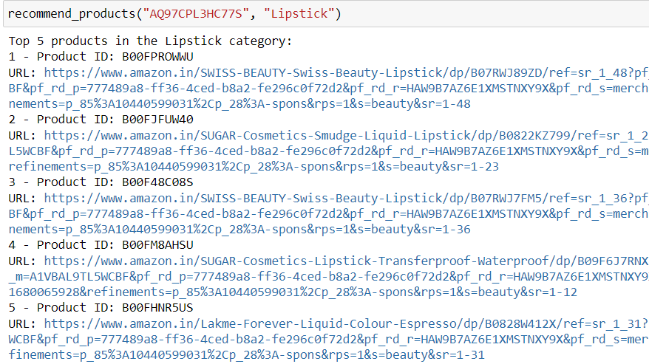
Recommendation
User-defined function that takes UserId & ProductType as input and returns Top Beauty Products
If the UserId is not from the trained data then it will recommend top products of that ProductType
# Function to recommend products based on user input
# If user is in the list, use recommender system elseif user is not in the list, recommend popular products
def recommend_products(user_id, product_type):
if user_id in beauty.UserId:
product_list = beauty.loc[beauty["ProductType"] == product_type, "ProductId"].unique()
predictions = [(product_id, model.predict(user_id, product_id).est) for product_id in product_list]
sorted_predictions = sorted(predictions, key = lambda x: x[1], reverse = True)
print("Top 5 products for user in the", product_type, "category:")
for i in range(5):
product_id = sorted_predictions[i][0]
url = beauty.loc[beauty["ProductId"] == product_id, "URL"].iloc[0]
print(i + 1, "- Product ID:", product_id, "\nURL:", url)
else:
top_products = beauty.loc[beauty["ProductType"] == product_type].groupby("ProductId")["Rating"].mean().sort_values(ascending = False).index[:5]
print("Top 5 products in the", product_type, "category:")
for i, product_id in enumerate(top_products):
url = beauty.loc[beauty["ProductId"] == product_id, "URL"].iloc[0]
print(i + 1, "- Product ID:", product_id, "\nURL:", url)

Slide 8
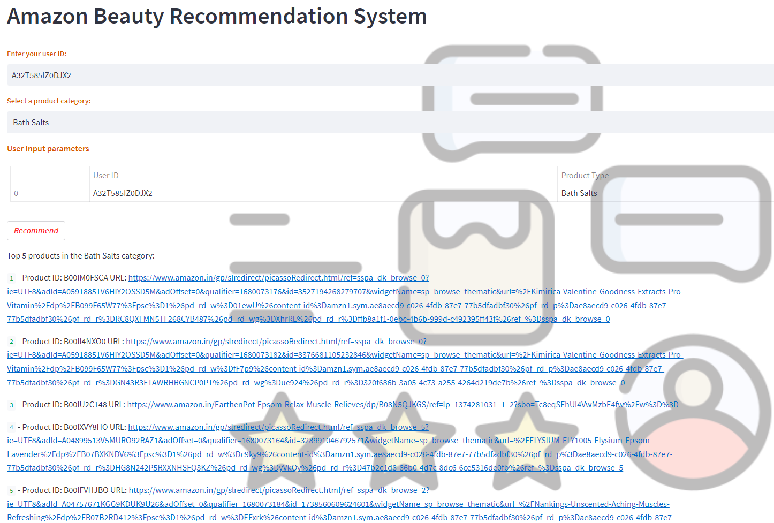
Deployment
Deployed model on Streamlit using command prompt
User Id and Product Type as user input
Recommend Button to Recommend Beauty Products URL

Slide 9

Thank
you

